Slide 1
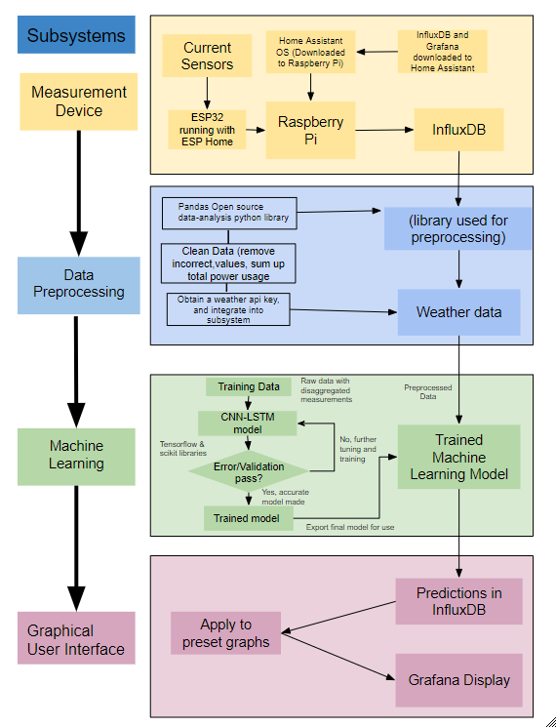

Project Introduction (Pre Design Day Review)
Residential Power Disagreggation - Team 50
Team: Andrew Bailey, Ralph Cullom, Manny Harris, Labib Kasim
Sponsor: Huangjie Gong (ABB)
Key features:
Device measures lumped power usage of a household.
Data is wirelessly transmitted to a database
Weather data is added
Machine learning algorithm disaggregates loads
Information is displayed to the user
Key Requirements:
Inexpensive
Size
User interface
Target Customers
Homeowners & Property Managers
Project issues/bottlenecks:
-ESP32 Current Measurements on NCSU network
Notes:
Labib
Key Features
Our device measures the total power usage of a household and then uses software to predict how much power each individual appliance used before displaying that info to the user. After using current transformers to measure the total power, the measurements are wirelessly sent to a database. Then, a weather API adds the temperature for the time the measurement was taken, and a machine learning algorithm disaggregates the total power into separate loads. After this is done, the total and disaggregated loads are displayed to the user on a graphical interface
Key Requirements
Inexpensive - Our project differs from other devices in price, with an estimated final cost of the product under $100.
Size - device shall be small enough to fit inside a residential distribution panel
User interface - The user should be able to comprehend the data displayed without a technical background
Target Customers & Usage
Homeowners using this device will be able to understand their power usage and can find which appliances may be upgraded to save money on their electricity bill. Property managers could do this on a much larger scale if they have multiple housing units they maintain
Yellow stoplight
ESP32 not yet reading current measurements, switching back to MQTT on Home Assistant OS

Slide 2
Design Day Setup
-Live view of Grafana and influxDB (on monitor)
-Shows total power, predictions being made, and cost
-Slideshow on loop (on laptop)
-Accomplishments, challenges, behind the scenes work
-Poster
-Demo of data collection using CT board with ESP32 connected or AD2 reading SPI if possible (measuring total on extension cord, and individual appliances on it measured)
Sponsor Closure Meeting
Scheduled for April 18th at 10AM
Notes:
Ralph

Slide 3
Team Charter - Project 50
Project Schedule
Issues & Help needed
Accomplishments
Risks
Action Items
Lessons Learned

Slide 4
Questions
and
Discussion
Notes:
Slide template from slides.com

